Slide 1
America’s gun culture
Iacob Sergiu

Slide 2
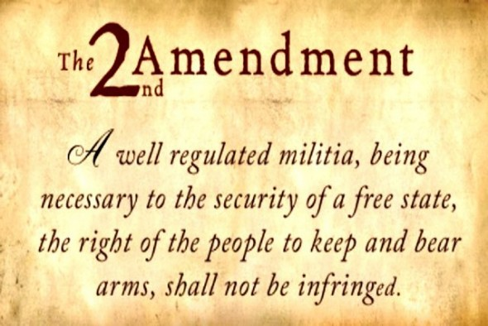
History 101
Independence fight, 227 years ago => Second Amendment

Slide 3
History 101
1871, NRA founded to combat any kind of gun control law; no gun-rights for black people (white afraid of revenge desire because of slavery)
2008, attempt to ban guns would violate the Second Amendment
Supreme Court, 2010: carrying a loaded gun allowed in any state
2011, one year later: approximately 90 guns per 100 people!

Slide 4
Statistics
No general minimum age, killing in public legal in some states
40% of Americans own/live in a household with a gun (2017); about 300 million firearms privately held (~1 for each citizen)
Americans own 42% of the world’s privately held firearms
~11000 murders involving a firearm (2016)
~22000 suicides involving a firearm (2016)
>1000 mass shootings since 2012
$6 billion yearly for the gun industry

Slide 5
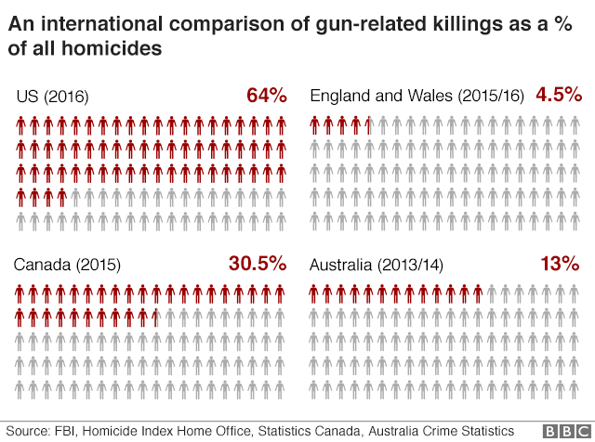
Statistics

Slide 6
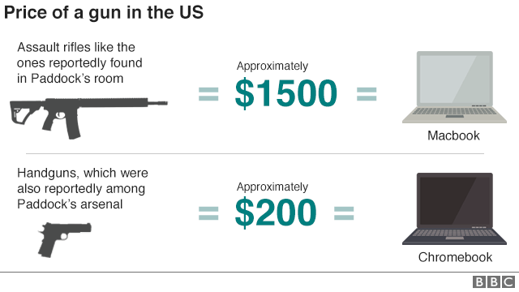
Statistics (S. Paddock, Nevada, 2017)

Slide 7
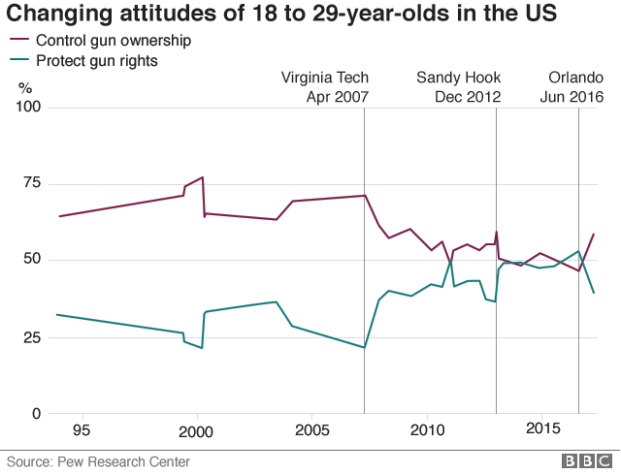
How do Americans feel about guns?

Slide 8
Why not just ban them?
NRA (National Rifle Association) opposes all forms of gun control; more guns make the country safer
NRA speds $3m anually influencing gun controls
Banning guns wouldn’t just make them go away (owned guns before banning them, illegal traffic etc.)
How do you take away 300m guns? (people don’t need to declare the guns they own)
US Government must support Constitution (the right to own a gun)

Slide 9
Why not just ban them?
PRO (People’s thinking)
Less suicides
Less violent crimes
Less threats
Certain kind of safety-feeling
CON (People’s thinking)
Less safety at home
Not as safe on the streets
Less protection (i.e. terrorist attack)
Government overthrowing US

Slide 10
Failed attempts
Massachusetts, 1976: ban all guns; 6 months to surrender the guns, otherwise 1 year in prison
Police objected: off-duty officers would be deprived of their guns
Rejected by 69% to 31% vote
California, 1982: same story
NRA spend $5m opposing California’s gun ban
Rejected by 63% to 37% vote

Slide 11
An example to follow
Lunatic kills 34 people in Tasmania
Australia banned semi-automatic rifles and shotguns in 1996
Purchased 650000 firearms from gun owners
2 mass shootings between 2000 and 2014
No other major incidents

Slide 12
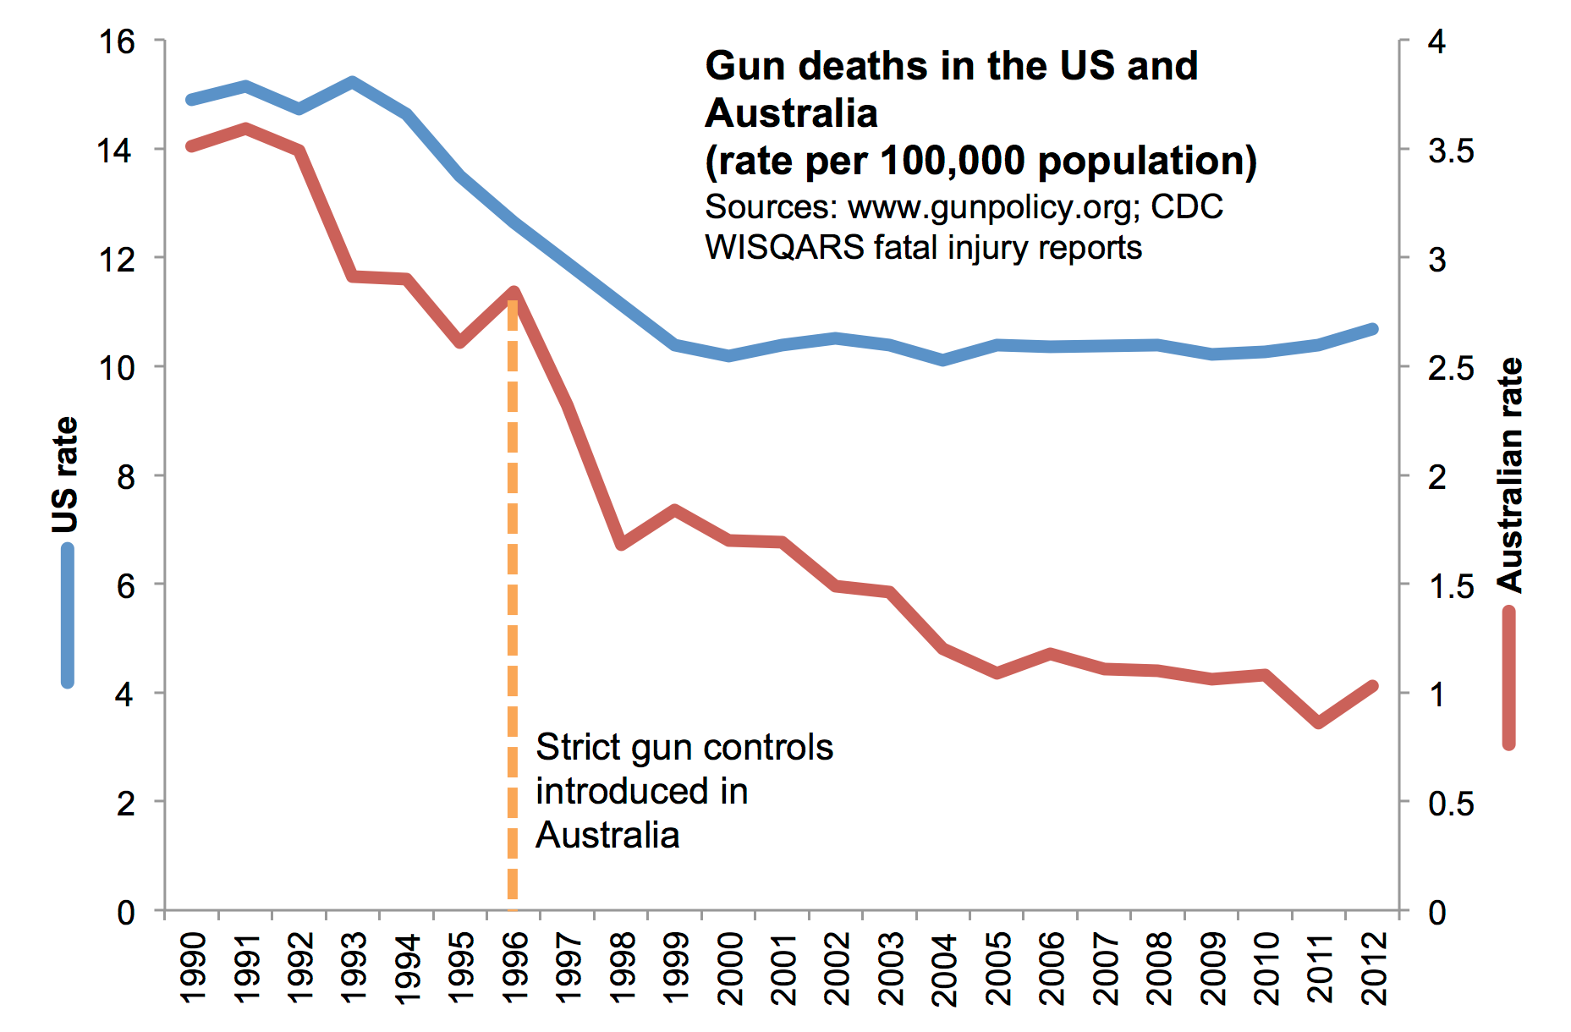
An example to follow: Australia vs USA

Slide 13
What do you think? How should they tackle this problem?

